Slide 1



HOUSE PRICE PREDICTION
Presented by Ishaan Barde

Slide 2


Abstract
The project aims to accurate prediction of housing prices is crucial in real estate-related applications. This study explores various machine learning techniques for predicting house prices.

Slide 3
House Price Prediction Using LSTM"
Keyu Zhang and Zhiqiang Wei (2018) : https://arxiv.org/abs/1709.08432
House Price Prediction with Machine Learning Techniques
A Review and Comparative Study by Wei Sun et al. (2020): https://www.researchgate.net/publication/325435801_House_Prices_Prediction_with_Machine_Learning_Algorithms
Deep Learning Model for House Price Prediction Using Heterogeneous Data Analysis
Along With Joint Self-Attention Mechanism: https://ieeexplore.ieee.org/document/9395585
House Prices Prediction Using Deep Learning : https://towardsdatascience.com/house-prices-prediction-using-deep-learning-dea265cc3154

Slide 4
1
2
THE PROCESS
DATA EXPLORATION
  Explore Dataset
  Identify Target Variable
  Gather Information
DATA PRE-PROCESSING
  Missing Values & Outliers
  Null Values
  Data Transformation
5
3
4
MODEL COMPARISON & EVALUATION
  Linear Regression
  Deep Learning
  LSTM
CATEGORICAL VARIABLE
  ANOVA
  Dummy Variable
  Binning
MODEL BUILDING
  Scaling
  Multi-Collinearity
  VIF

Slide 5
THE ALGORITHMS USED ARE:
LINEAR REGRESSION
LSTM

Slide 6
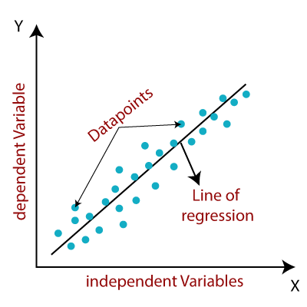
LINEAR REGRESSION

Slide 7
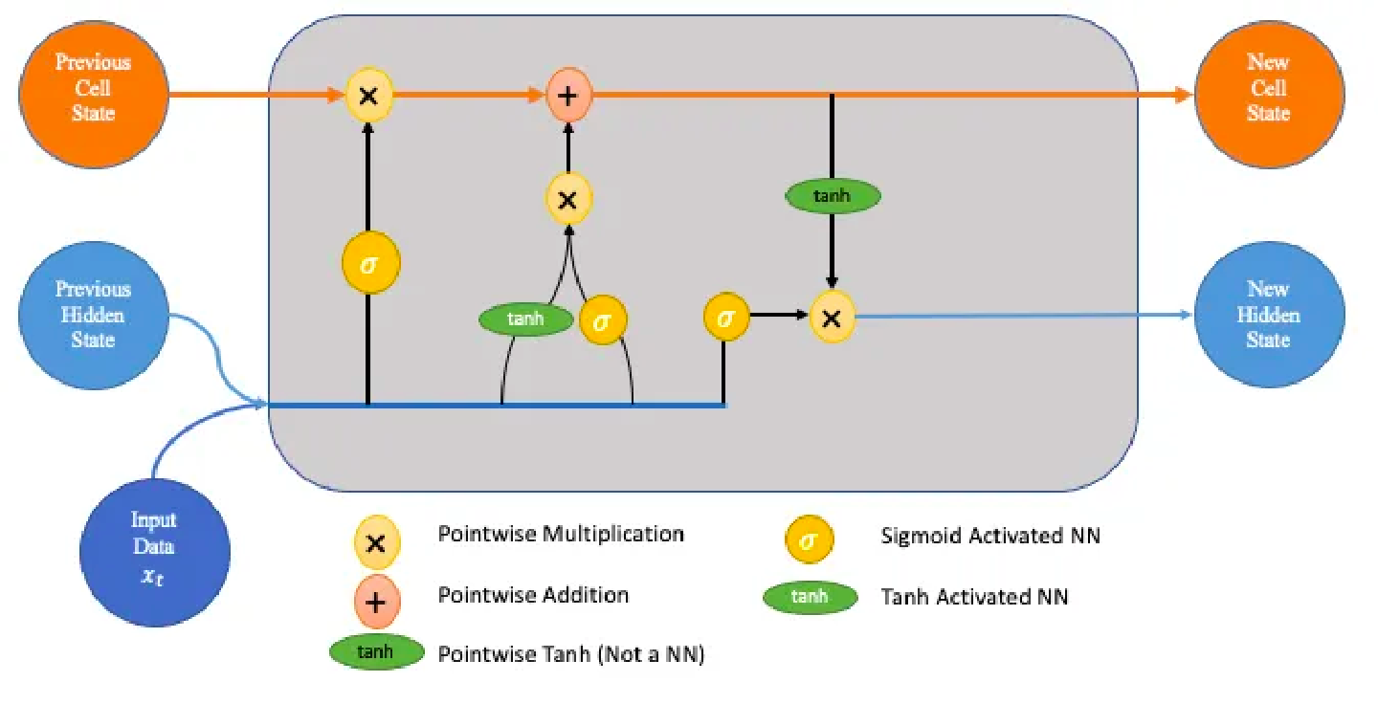
LSTM
(Long-Short Term Memory)

Slide 8


COMPARISON
Deep Learning Algorithm
ML Algorithm
I created a Linear Regression Model with the keras library.
A deep learning model has been developed for the same dataset using the Linear Regression model.

Slide 9
OPEN FOR ANY QUESTIONS

Slide 10

Thank You

